Slide 1
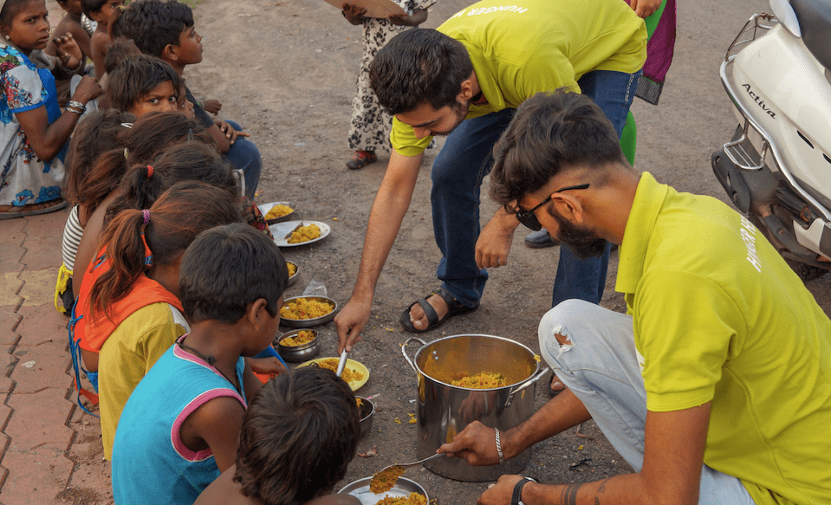
Food Management: Connecting Communities
Our mission is to alleviate food insecurity by connecting those in need with available resources.
DP
by Dharmendra Patel

Slide 2
Mission and Vision
Mission
Vision
To bridge the gap between food surplus and food insecurity through a user-friendly platform.
A world where everyone has access to nutritious food, fostering stronger communities.

Slide 3
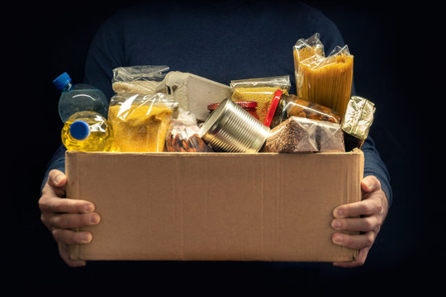
Donate Page
1
Food Donations
Contribute fresh produce, pantry staples, or prepared meals.
2
Financial Support
Make a financial contribution to support our operations.
3
Volunteer Time
Donate your time to help us pack, sort, and deliver food.

Slide 4

Request Page
Food Requests
Contact Information
Submit a request for food assistance based on your needs.
Provide your contact details for efficient communication.
Delivery Options
Choose pickup or delivery based on your preference.

Slide 5

How it Works
Donors contribute food, funds, or time
Volunteers sort and package donations
1
2
3
4
Requests are submitted by individuals or families in need
Food is distributed to those in need through pickup or delivery

Slide 6
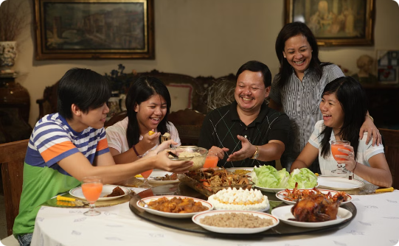

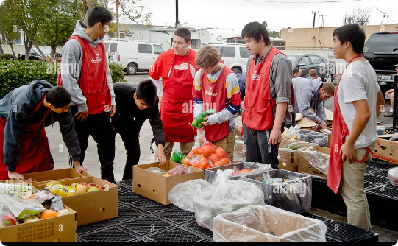
Success Stories
Family Reunites
Senior Citizen Support
Community Collaboration
A family struggling financially receives enough food to cook meals together.
A senior citizen with limited mobility receives regular food deliveries.
Local businesses donate excess food, reducing waste and aiding those in need.

Slide 7




Volunteer Opportunities
Food Sorting
Delivery Drivers
Help organize and package donations for distribution.
Deliver food to families and individuals in need.
Administrative Support
Assist with data entry, communication, and other administrative tasks.

Slide 8

Join Our Movement
Together, we can make a difference in the lives of those facing food insecurity. Join our movement today and help us build a stronger, more compassionate community.

